Slide 1

Members: MD Shamiul Islam ID:18192103241 Khaled Hasan ID:18192103266 Julker Nayeem ID:18192103227 All Moon Tasir ID:18192103256
BUBT Affix
Supervised By:
Md. Anwar Hussen Wadud
Assistant Professor Department of CSE
Bangladesh University of Business & Technology

Slide 2
OVERVIEW
Introduction
Motivation
Objective of the Project
Purpose of the Project
Project Review
Requierment Analysis
Implementation
Limitation Project
Future Enhancement
Conclusion

Slide 3
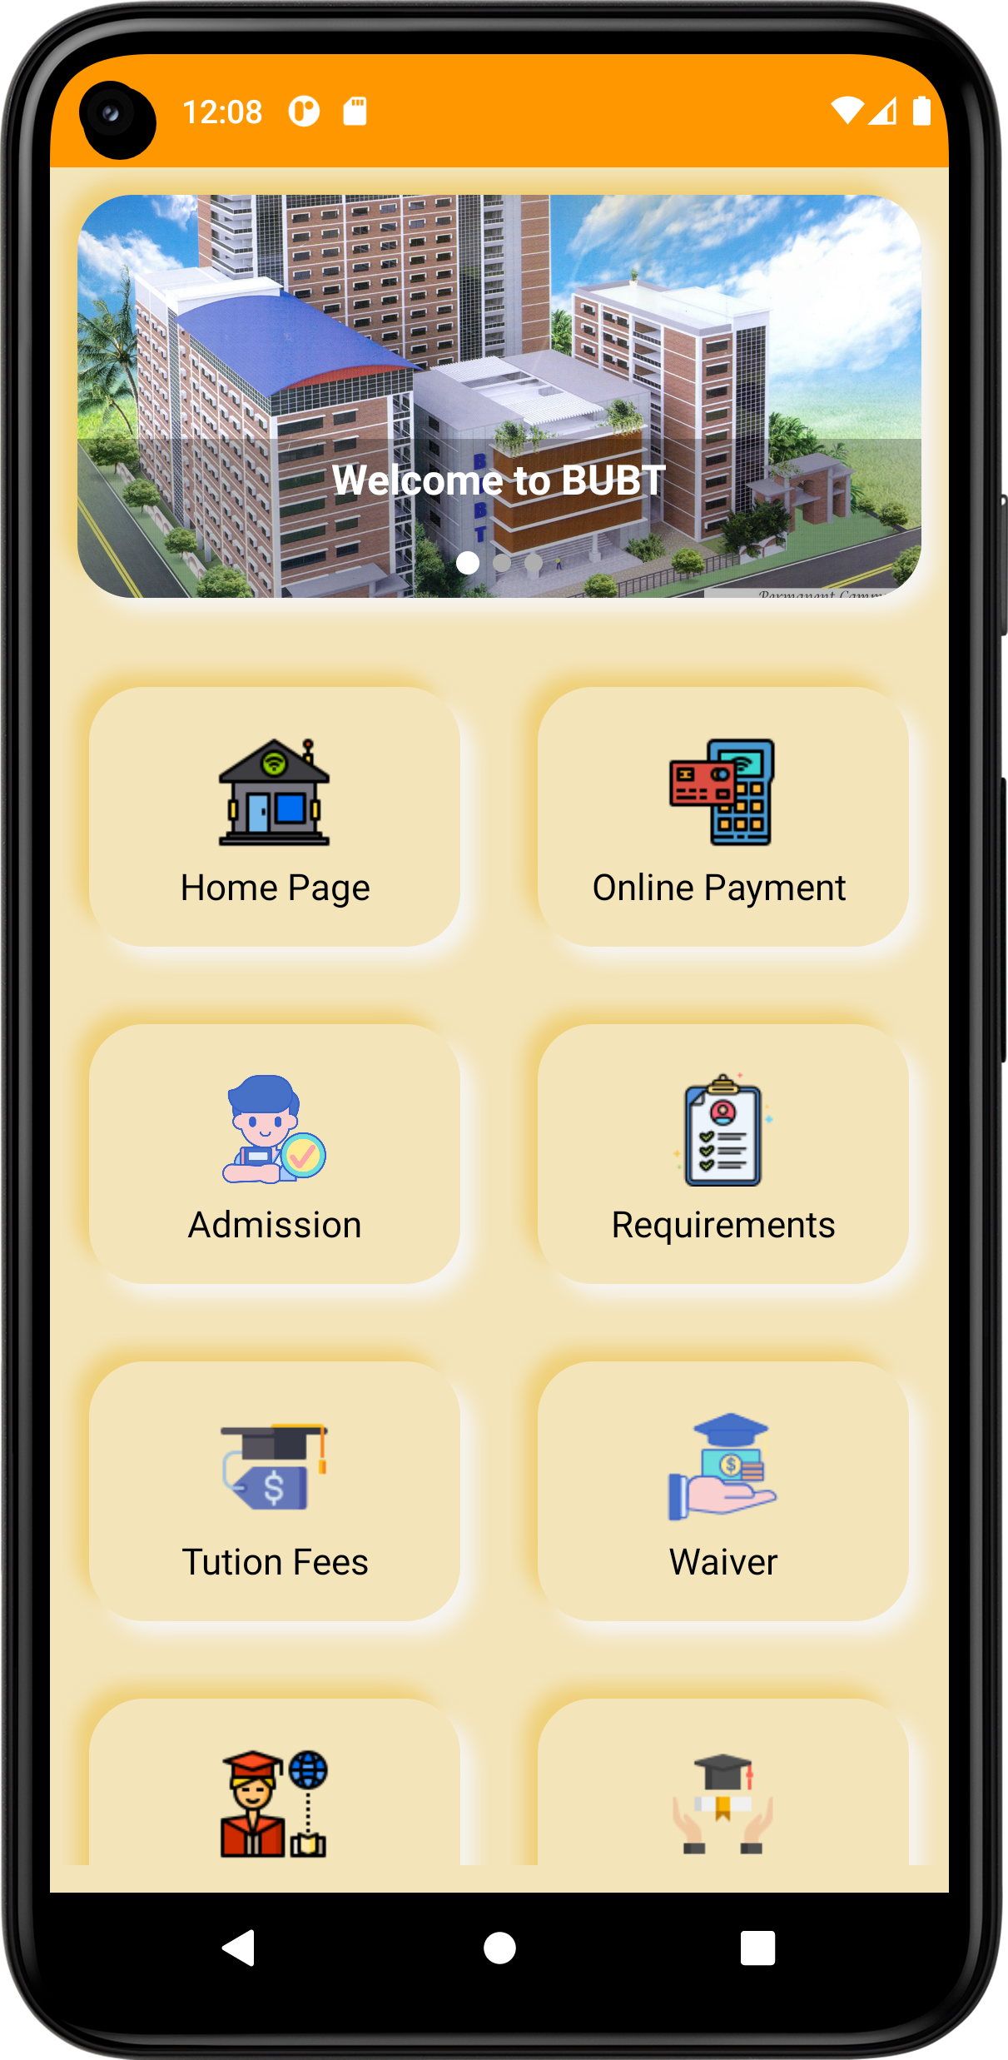
Introduction
BUBT AFFIX project is designed keeping focused on the all student of Bangladesh University of Business and Technology. It can maintain the all website facilities in a processed and organized way in online. It is designed for all types of Users. BUBT Affix shortly known as BUBT-AX is an online portal for the students and teachers of BUBT. It is a one stop web portal service where ongoing / running students can get their academic information from anywhere.

Slide 4

Motivation
BUBT-AFFIX as like as one stop service for BUBT students & faculties member. We made that for more usable, user friendly & more time consuming for all users. Anyone can act any kind of University's work by using it.

Slide 5

Objective of the Project
We know the main three objectives of a projects are:
To manage BUBT AFFIX activities centralized and productively.
The proper way of Task Management.
Time, Quality, Outcome. The main point of this chapter is to define the goal and scope of the project so clearly that measuring progress is easy, and that there is no ambiguity that the project goals have been achieved.
Create Useable goal and objective statements .
Effort Estimation, Cost Estimation.
Project planning To finish the project.

Slide 6
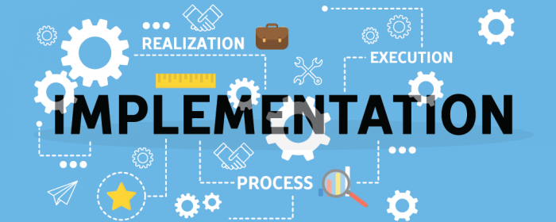
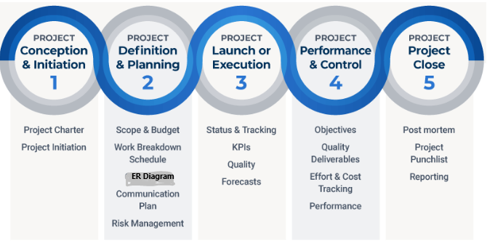
IMPLEMENTATION
There are several steps involved in implementing a project, including some planning that must occur before the implementation can begin.

Slide 7
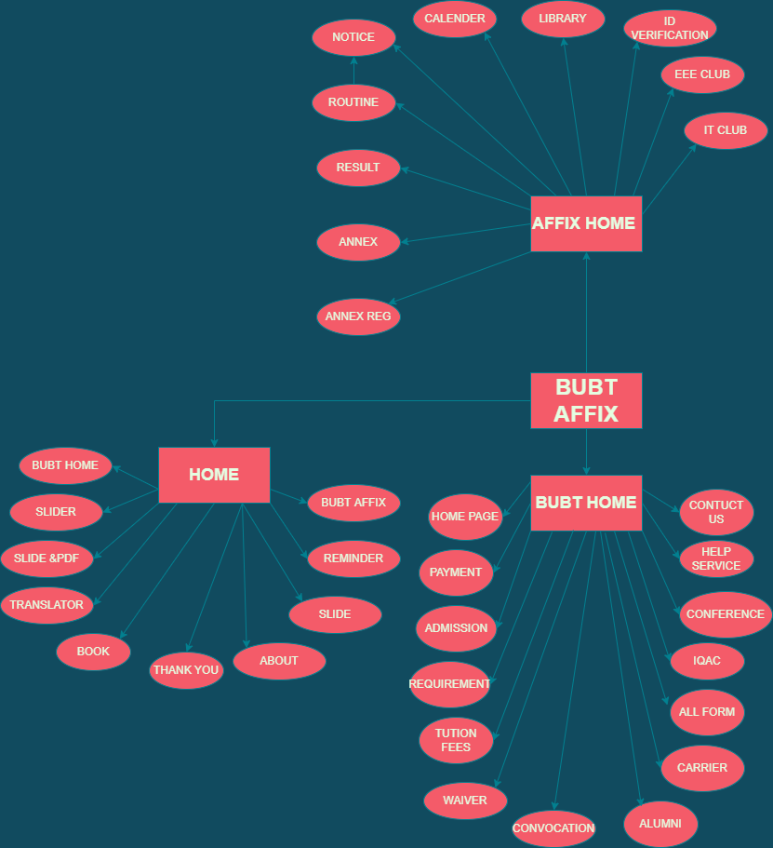
PROJECT REVIEW

Slide 8



REQUERMENT ANALYSIS
Tools :
Android Studio
LottieFile Animation
Programming Language and Database :
JAVA
Firebase

Slide 9
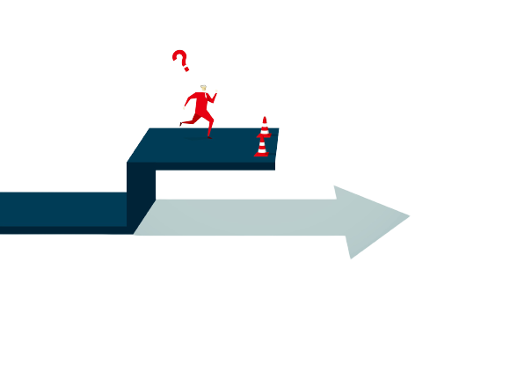
PROJECT LIMITATION
It is only android version
Not enough feature to detect outside students of BUBT
We cannot access main database BUBT admin

Slide 10

FUTURE ENHANCEMENT
’Upcoming Event’ and ’Task Scheduler’ have to update.
Fully customizes profile module
Feature to detect outside students of BUBT
Chatting system
Tutorial video playlist

Slide 11

CONCLUSION
We investigated the issue and did our best to solve any issues that arose in the course of the project. This Application is helpful to maintain all data of a student also for instructors. User can show their Permitted information of their choice at any time any where. Also teacher can maintain their academic Notice or upload information by this app from any where any time. We are hopeful that we will be able to develop the project as outlined as soon as feasible. Thank you for your time and consideration. I’d want to use this chance to present my work and ideas to you.

Slide 12


ANY QUESTION?

Slide 13


